Slide 1

МРС Mobile Banking App
Мариян Апостолов
ФН 791322015

Slide 2
Описание на програмата
Програмата е написана на езиците Python API / Android (Java)
Criterion 1: Capture Client Requirements based on the SoW
Criterion 2: Backlog creation - in user stories & story pointing
Criterion 3: Identify external dependencies, key risks and issues
Criterion 4: Distribute the roles in the team, taking in mind there are separate build & test roles (Developer, QA, Scrum master, PO)
Criterion 5: Create an architecture diagram for the application, including class diagram and DB schema
Criterion 6: Wireframes with high level design of the interfaces
Criterion 7: Release plan creation, broken down in Sprints + formulating Sprint goals
Criterion 8: Milestone plan creation
Criterion 9: Tasks distribution
Criterion 10: Present a proposal for sprint reporting or end of project reporting (what metrics will be shown and what is the value added)
Criterion 11: Hold retrospective meeting, share results and identify process bottlenecks & improvement areas

Slide 3
Criterion 1: Capture Client Requirements based on the SoW
Client requirements based on the SoW Document
Creation of a bank account
Creation of credit card
Send money to another account
Send money between own accounts
Seeing the history of transactions

Slide 4
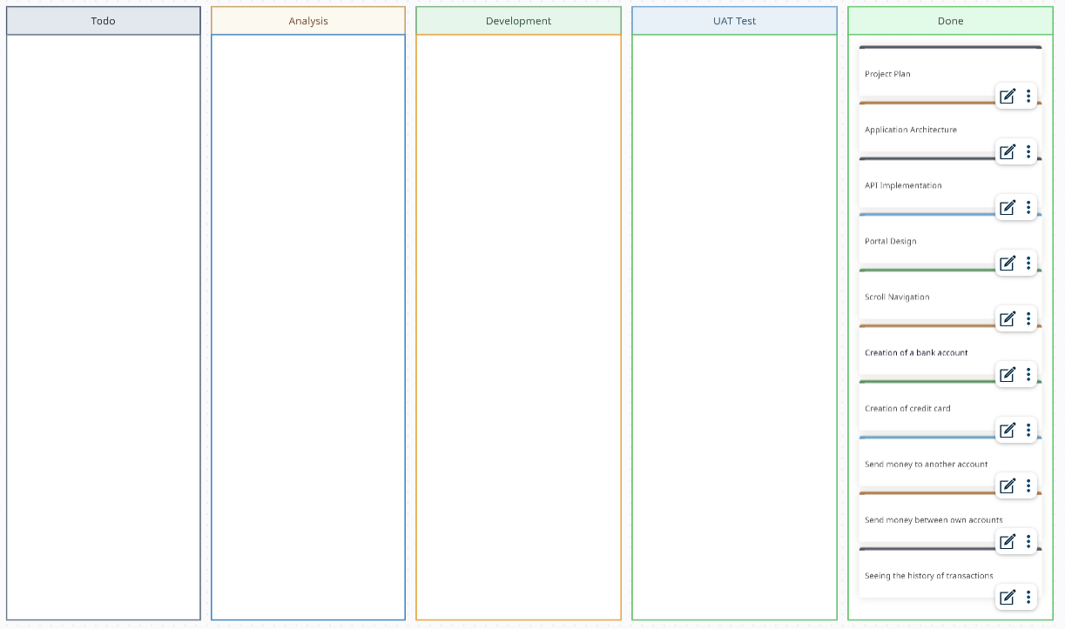
Criterion 2: Backlog creation - in user stories & story pointing
Backlog Stories:
Project Plan
Application Architecture
API Implementation
Portal Design
Scroll Navigation
Creation of a bank account
Creation of credit card
Send money to another account
Send money between own accounts
Seeing the history of transactions

Slide 5
Criterion 3: Identify external dependencies, key risks and issues
External dependencies:
Python API
flask
flask_sqlalchemy
swiftcrypt
datetime
decimal
random
Android Java
androidx.appcompat:appcompat:1.6.1
com.google.android.material:material:1.11.0
androidx.constraintlayout:constraintlayout:2.1.4
junit:junit:4.13.2

Slide 6
Criterion 3: Identify external dependencies, key risks and issues
Key risks and issues:
Fake mobile banking apps
“Keylogging” malware that’s hidden in other apps
Trojan overlays that misdirect your transactions
SIM swaps that take control of your phone
Wi–Fi hacking (man-in-the-middle attacks)

Slide 7
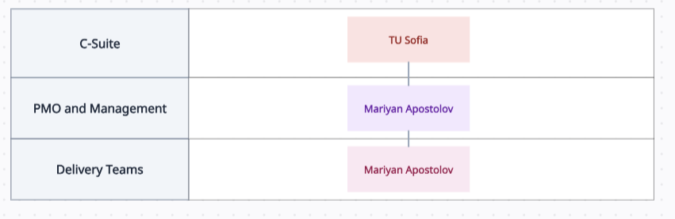
Criterion 4: Distribute the roles in the team, taking in mind there are separate build & test roles (Developer, QA, Scrum master, PO)
Contact | Email/Cell
PO: Mariyan Apostolov | Mariyan.Apostolov89@gmail.com
Scrum Master: Mariyan Apostolov | Mariyan.Apostolov89@gmail.com
Developer: Mariyan Apostolov | Mariyan.Apostolov89@gmail.com
QA: Mariyan Apostolov | Mariyan.Apostolov89@gmail.com

Slide 8
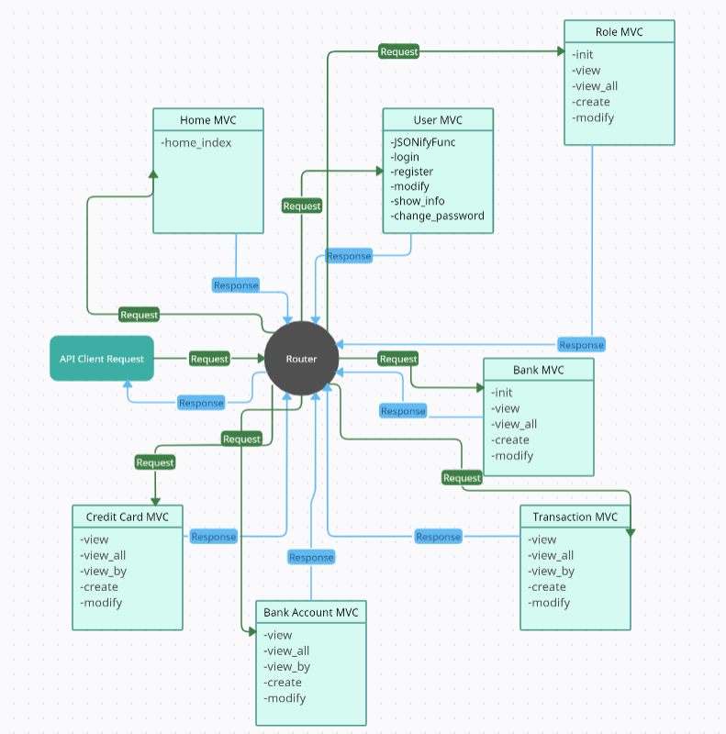
Criterion 5: Create an architecture diagram for the application, including class diagram and DB schema
Class Diagram (Python API)

Slide 9
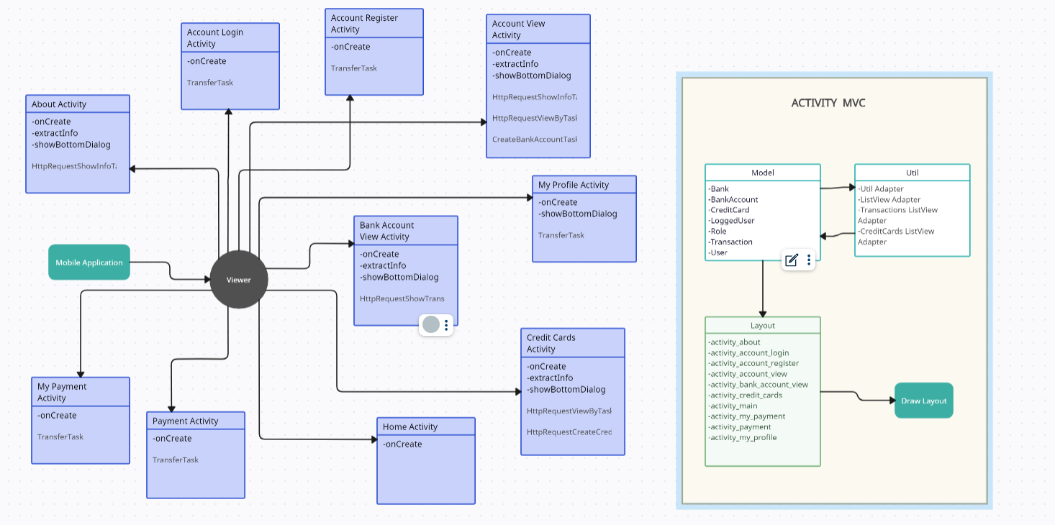
Criterion 5: Create an architecture diagram for the application, including class diagram and DB schema
Class Diagram (Android Java)

Slide 10
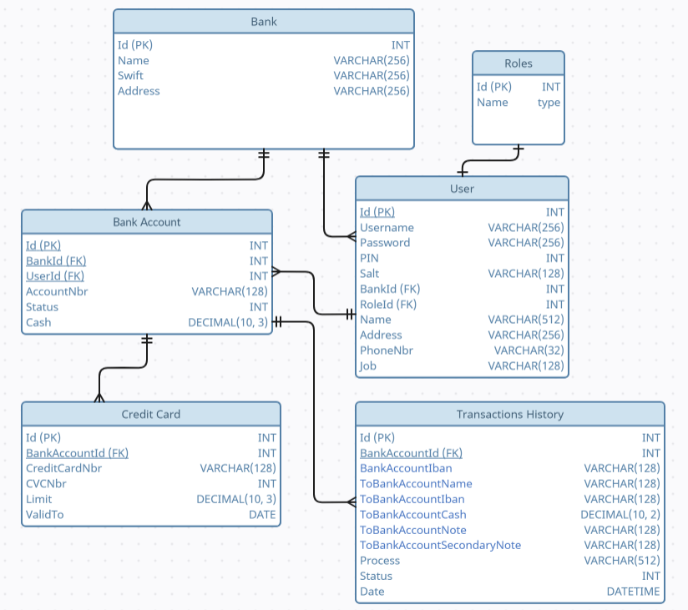
Criterion 5: Create an architecture diagram for the application, including class diagram and DB schema
DB Schema

Slide 11
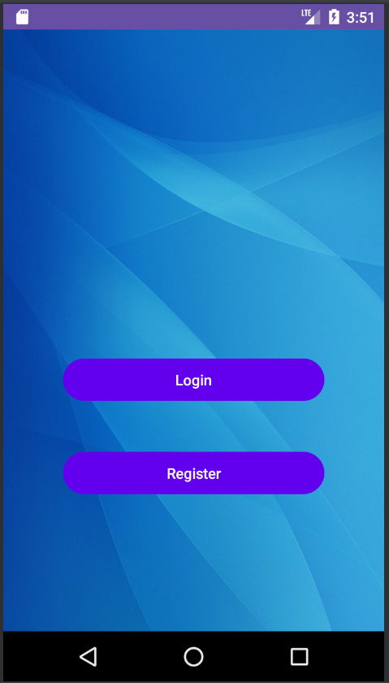
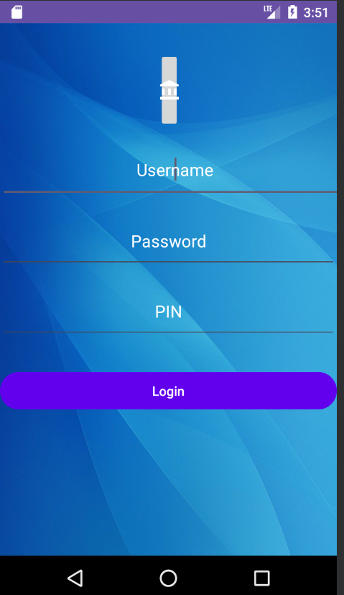
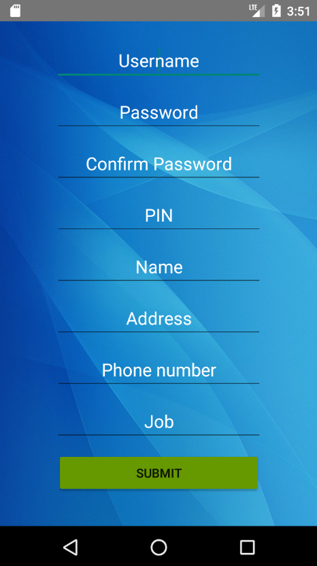
Criterion 6: Wireframes with high level design of the interfaces
Home modules

Slide 12
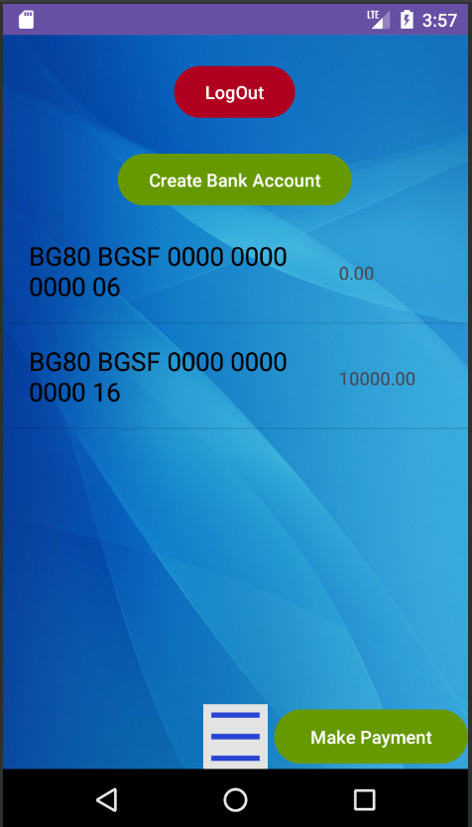
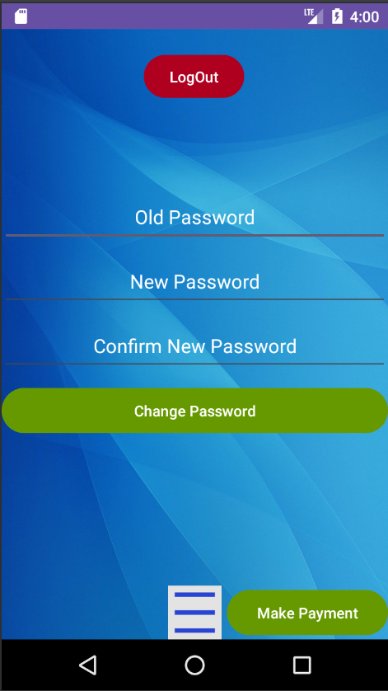
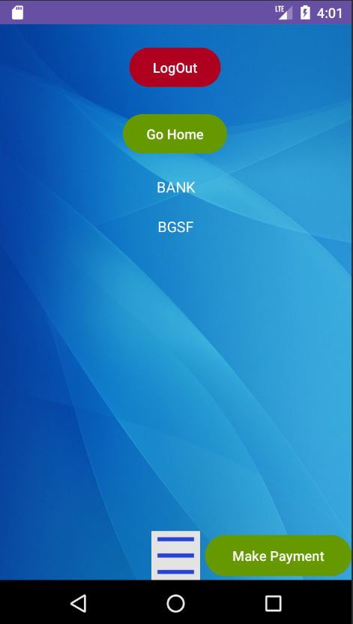
Criterion 6: Wireframes with high level design of the interfaces
Bank Account & Profile & About modules

Slide 13
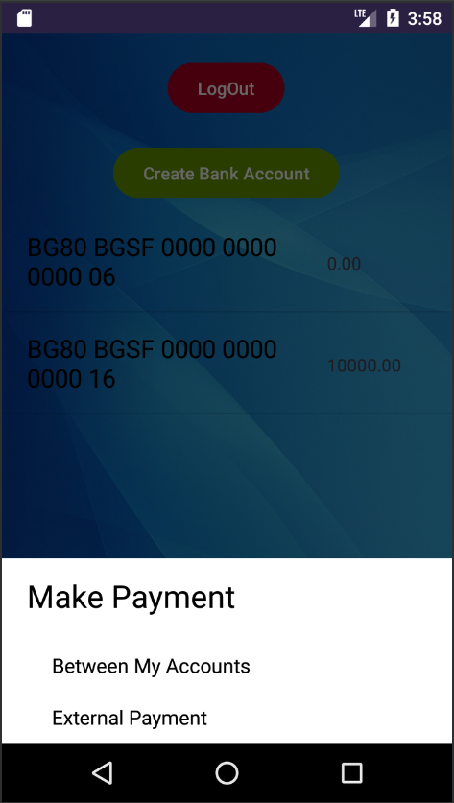
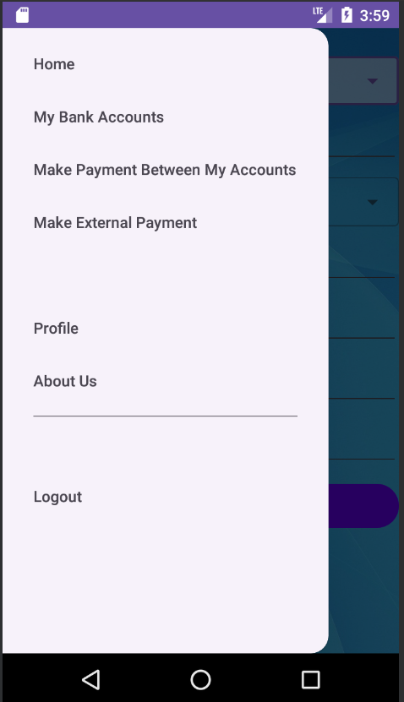
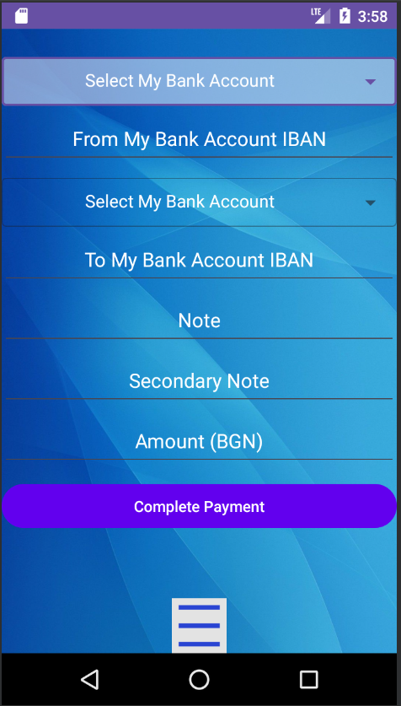
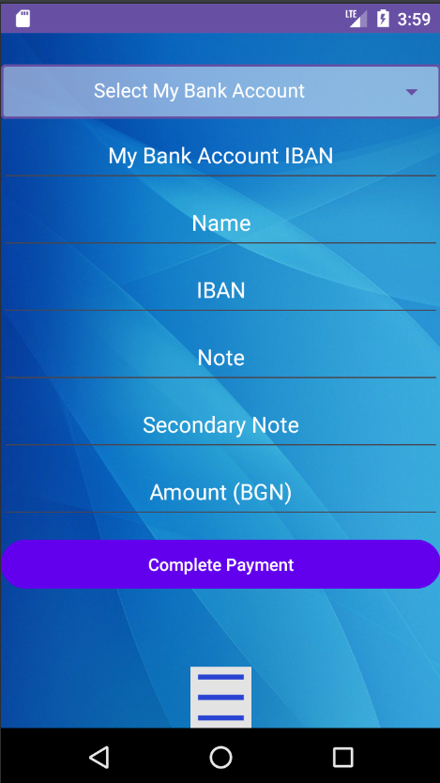
Criterion 6: Wireframes with high level design of the interfaces
Make Payment modules

Slide 14
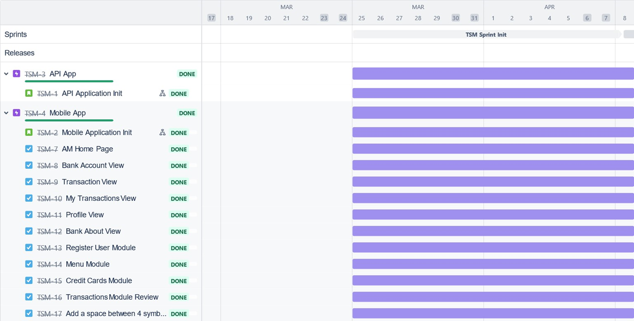
Criterion 7: Release plan creation, broken down in Sprints + formulating Sprint goals

Slide 15
Criterion 8: Milestone plan creation
Milestones | Start Date | Finish Date
Project approval | 1W 03.2024 | 2W 03.2024
Objectives and goals | 1W 03.2024 | 2W 03.2024
Environments | 1W 03.2024 | 2W 03.2024
Planning | 1W 03.2024 | 2W 03.2024
Resources | 2W 03.2024 | 3W 03.2024
Decisions | 2W 03.2024 | 3W 03.2024
Design approval | 2W 03.2024 | 3W 03.2024
Processes | 4W 03.2024 | 1W 04.2024
Deliverables | 4W 03.2024 | 1W 04.2024
Soft target dates | 4W 03.2024 | 1W 04.2024
Project completion | 4W 03.2024 | 1W 04.2024

Slide 16
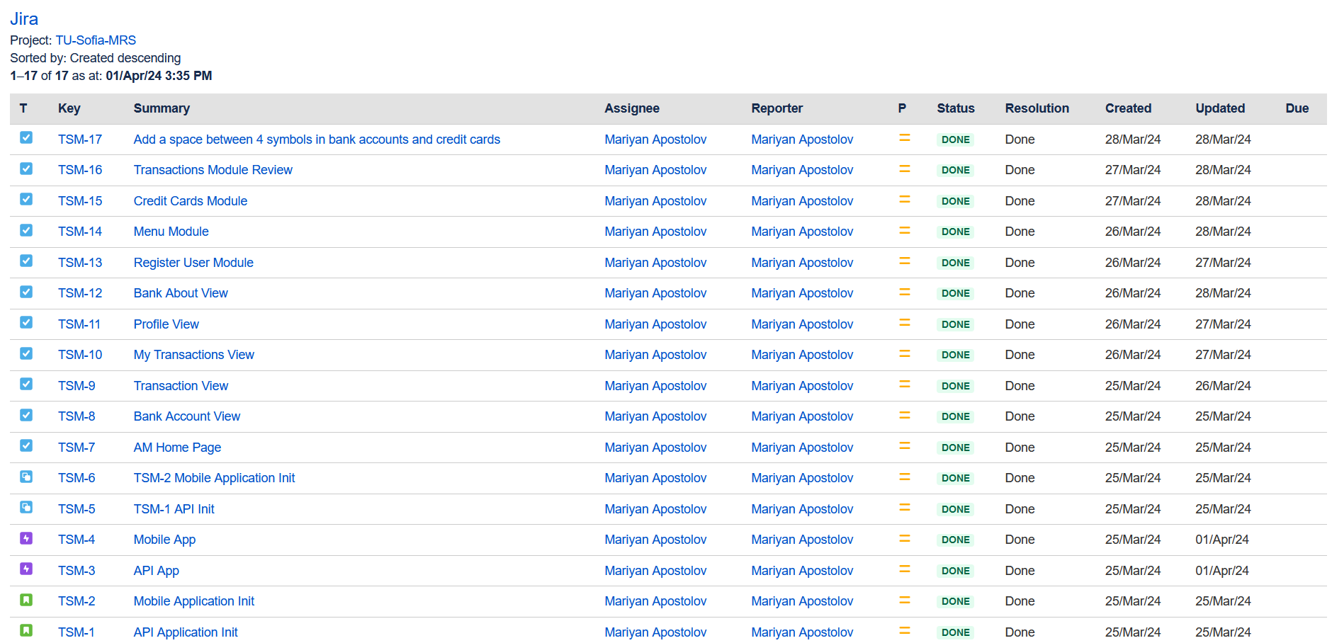
Criterion 9: Tasks distribution

Slide 17
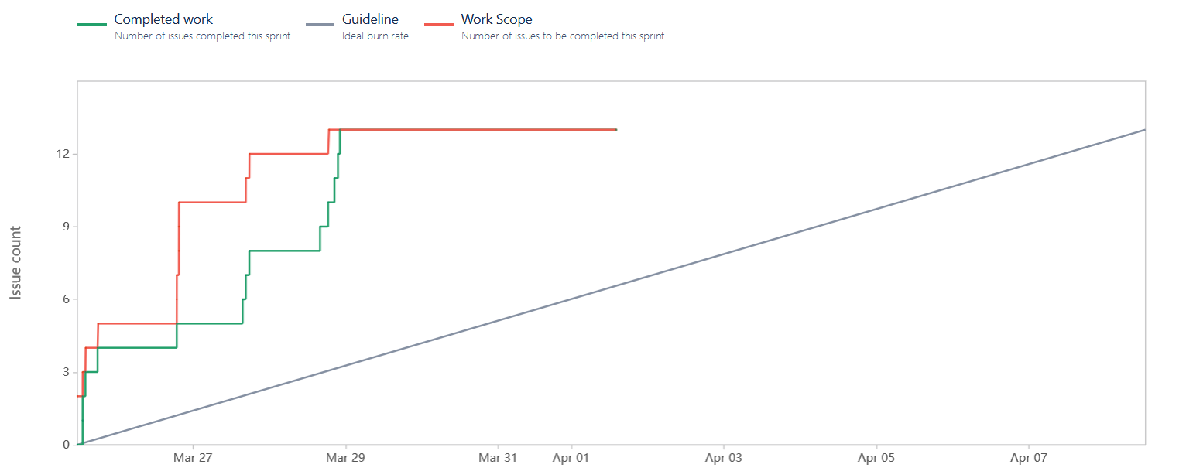
Criterion 10: Present a proposal for sprint reporting or end of project reporting (what metrics will be shown and what is the value added)
Burnup report

Slide 18
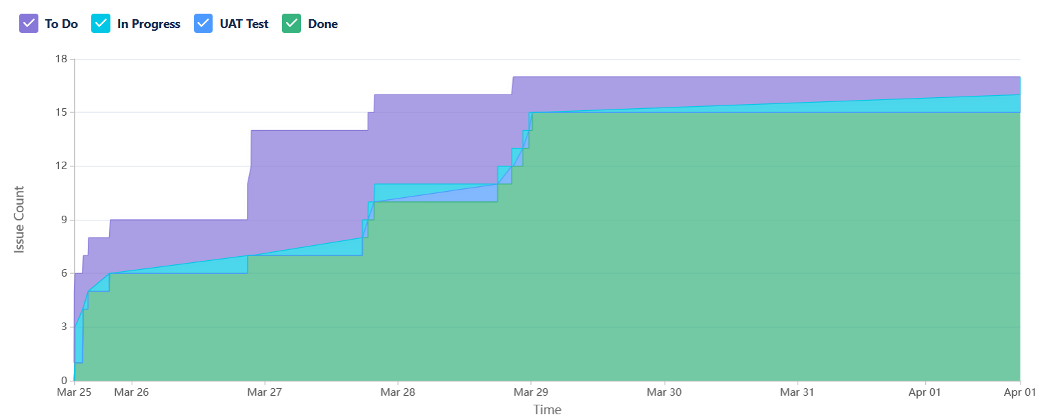
Criterion 10: Present a proposal for sprint reporting or end of project reporting (what metrics will be shown and what is the value added)
Cumulative flow diagram

Slide 19
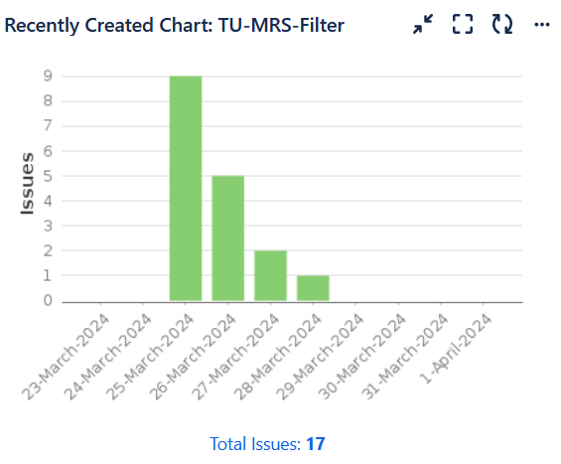
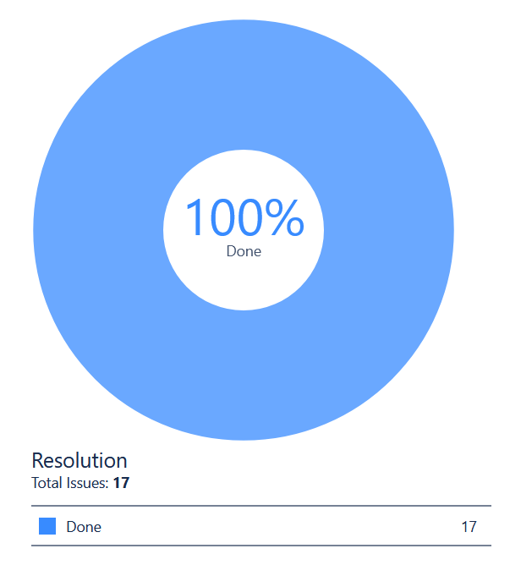
Criterion 10: Present a proposal for sprint reporting or end of project reporting (what metrics will be shown and what is the value added)
Implementation Charts

Slide 20
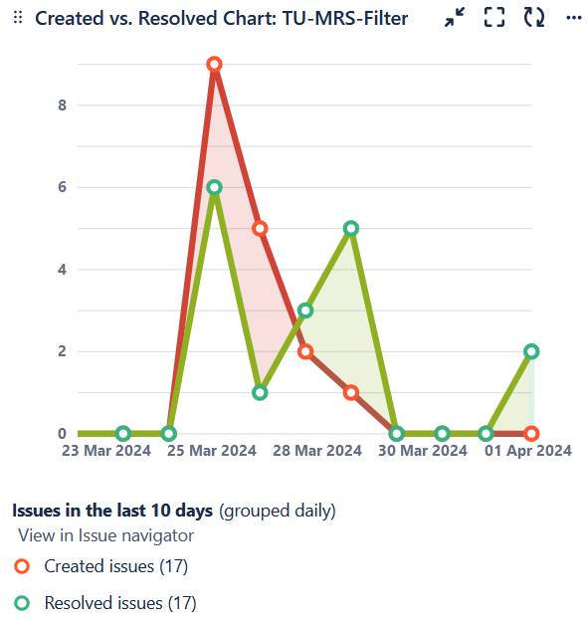
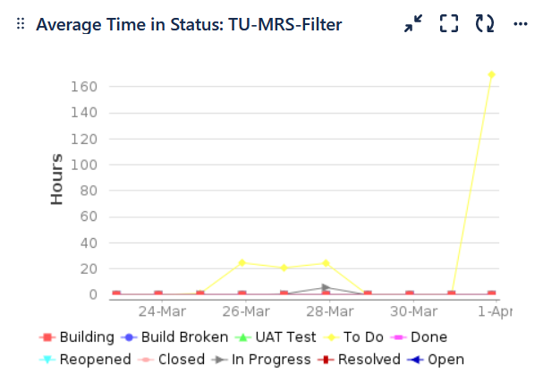
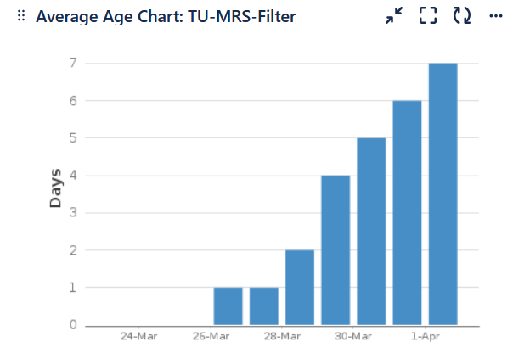
Criterion 10: Present a proposal for sprint reporting or end of project reporting (what metrics will be shown and what is the value added)
Implementation Charts

Slide 21
Criterion 11: Hold retrospective meeting, share results and identify process bottlenecks & improvement areas
Results:
Login Security Enhancement for Fake Apps, Malware and Man-in-the-Middle Attacks
Responsive Android Elements on Phone Screen
Process bottlenecks:
Python MySQL Flask ORM Implementation
Android Application Connect to API
Draw Responsive Android Elements on Phone Screen

Slide 22
Criterion 11: Hold retrospective meeting, share results and identify process bottlenecks & improvement areas
Improvement Areas:
Export PDF module
Multi/Two-Factor Authentication
SMS Authentication
Add Loan Requests

Slide 23

LIVE DEMO

Slide 24
Documents
Statement of Work
Gantt Chart
Task Tracking Template
Issue Tracking Template

Slide 25
Благодаря
Мариян Апостолов
ФН 791322015
mariyan.apostolov89@gmail.com
marapostolov@tu-sofia.bg
Линк към GitHub:
https://github.com/MApostolov-TU-Sofia/MRS-project

